Slide 1
Limbic Leadership
Development

Slide 2
We work with the mostly UNSEEN areas
to make lasting change seen in people’s…
Thoughts​
Emotions
Behaviors & Leadership.
Core Beliefs
Personal Values​
Attitudes

Slide 3
The Limbic Performance System™ (LPS) is effective because it goes below the “behavior iceberg” to work with all the drivers for how we lead ourselves & others.
Our Approach & Why it Works
It is quite simple – if you want to produce lasting change & long-term wellness then you MUST go below the surface and change things in our subconscious brain (or Limbic System).

Slide 4
Our program will help your organization’s leaders:
Build self awareness & awareness of others as a foundation to being a great leader.
Gain clarity on both individual and team’s Purpose to a ensure a long-term vision is in place & increase engagement with the organization’s goals & vision.
Achieve goals (individual & team) by removing interferences and creating clarity on values (both personal & team)
Build long term resilience by developing and increasing self belief
Engage with & use Conflict and differences productively
Align their values across teams & different cultures so they can communicate effectively and efficiently with one another.
Increase their self confidence and thereby be an authentic leader.
We will customize the program based on your needs.

Slide 5
1. DISCOVERY/ CLARIFICATION OF NEEDS
Discover what is working & what needs to be developed. This can be done through our pre-assessments and/or focus groups.
2. SET ROI MEASUREMENTS
We will agree on measurable targets and KPIs before the program starts.
How
we will work together
3. DESIGN PROGRAM
Our collaboration
We will co-design a program with you that will ensure your return on investment.
4. ENGAGE & EVALUATE
Together, we will engage and evaluate progress each step of the way. We are a boutique firm looking for 100% satisfaction.
5. MEASURE OUTCOMES
Measure ROI and make sure desired outcomes were met.

Slide 6
Self Study on Online Platform
An example format of the training
Weekly or Bi-Weekly
Interventions include
Webinar to Kick off program
Assigned
Self Study
on Online Platform
Post-course Assessment
Wrap up Webinar
Pre-course Assessment
01
02
Buddy chats
03
Live Zoom Team coaching & action planning session

Slide 7
Example Measures of Success
Improvements in Personal Results
Mapping to existing Personal Development items to see the impact on behavior & results (see next slide)
KPI’s based on Personalized assessment (done before & after program)
Long lasting changes in communication, collaboration, Inspirability & interpersonal impact
Improvements in Team & Business Results
Mapping to existing KPI’s to see the impact
Concrete behavior changes like better collaboration & interpersonal impact
Better results, more engagement, long term motivation
© BCS 2015

Slide 8
This program was an incredible gift and perspective shifter. I feel clarity and peace unlike anything before. I have never felt this grounded in my life.
There are two periods in my life: before and after I did this program.
I've "met” the TRUE ME &
I have the courage to share this with the world in a way that builds relationships. Quite simply, this program has changed my life.
I’ve learned how to recognize and manage my emotions, which reduced my stress levels. I’ve got a clear understanding that the diversity of the people who surround me is a benefit, not something, which needs to be changed and adopted to my personality.
“
I feel better, stronger, more energized, more confident, more alive & happier than ever before.
Clients love this life changing program
If I could give one gift to everyone in this world, it would be the journey I’ve had on this program. I feel privileged and very grateful to have been given the opportunity to learn, grow and become a happier person.
This program leads you brilliantly through the journey of self-understanding and understanding of others which has changed my life.

Slide 9
Session # | Key things I learned during this module | Behaviors I want to change | Results (tangible changes made)
1 | My performance depends on my interferences (Mine: I avoid conflict) | When I disagree with someone, I approach the situation to solve it. Example: I don’t agree with X right now about X, I will meet with him. | I met with X and we discussed X problem and resolved it.
2
3
4
5
6
7
8
9
Impact Map (each participant)
The Impact Map is personal.
Starts at training session 1 & kept as a running document until we finish.
All Impact Maps are stored in shared folder.
Participants to update day after and day before live training session.

Slide 10
AVOID THE HONEYMOON EFFECT
Participants get 24/7 unlimited access to our Online platform & this combined with Live webinars, buddy chats & coaching will help avoid the typical honeymoon effect with most developmental programs.
DEVELOPMENT THAT LASTS
We go below the surface to help people increase their understanding of self & relational behavior competencies based on neuroscience.
Learning Methods that Work
ENHANCED TEAM PERFORMANCE
Once we have a better understanding of self, we are more equipped to understand and value others. People can inspire in a whole new way, building trust, easily handling conflict and leading or participating in teams more authentically & effectively.
PERSONALIZED & MEASUREABLE
Each participant will get a pre & post program diagnostic assessment with individual measurements using our Limbic Performance Indicator tool.

Slide 11
About us
based on Neuroscience not on popular trends

Slide 12
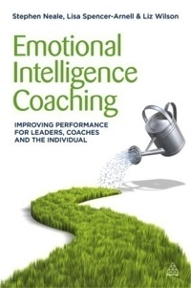
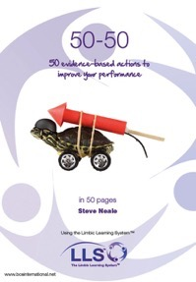
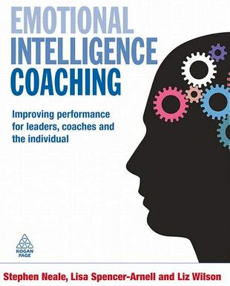
Executive MBA Programs BMI, Vilnius, Lithuania
Portsmouth University, UK
Louvain School of Business, Belgium
Aalborg University
ISM
The Limbic Performance
System™
High quality
40,000+ people trained
100 % recommendation rate
Nominations Financial Times
Sachs Best
Business Book
2009
Publications
5 books
12 languages
System Used by
the United Nations
to help
20 Million People
Winner of Best Training Course,
UK Government Award

Slide 13
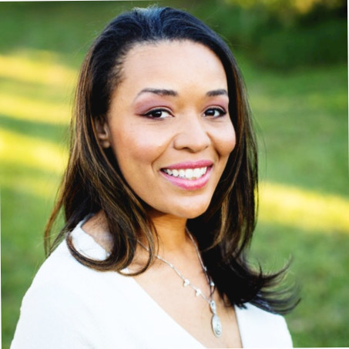
Lynnette is a dynamic coach, consultant and speaker who works with organizations by creating connection and empowering leaders to make lasting changes to create any result that they want.
She brings 17 plus years organizational leadership experience from one of the World’s most well-known and admired brands: Walt Disney World.
She co-authored the book, It's Possible: A Dreamers Manifesto to Overcome Opposition. This Manifesto is a dreamer’s guide to improve self-talk, increase faith and act in the direction of their dreams.
She is a graduate of Regent University where she obtained a Master’s Degree in Organizational Leadership and Executive Coaching.
She is also Co-Founder of the Fulfilled Mom Movement a group of values-based coaches curating a space for moms to design a life they love.
About your partners
Lynnette Phillips
LPS Facilitator, Executive coach, Speaker, Organizational leader, Wife & Mom

Slide 14
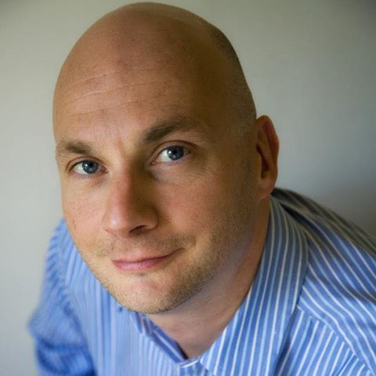
Steve is a dynamic and engaging speaker, trainer, consultant and coach who has helped more than 40,000 leaders over the last decade and more.
He currently teaches on more 5 international Executive MBA Programmes around Europe.
He recently won the UK Government Award for Best Training Course and his book, Emotional Intelligence Coaching, was nominated for the Financial Times Goldman Sachs Best International Business Book of the Year Award.
He is the founder and developer of the Accredited Masters in High Performance Leadership Programme and the Creator of the comprehensive and practical online leadership course, the Limbic Performance System for Outstanding Leadership.
He has a unique ability to take the newest and most useful science on human behavior and translate it into accessible, practical tools. He delivers this knowledge and these tools in an engaging and unique way – always with a focus on helping you with lasting change and bottom line.
About your partners
Steve Neale
Creator of the LPS, qualified physiologist, psychologist, executive coach, hypnotherapist, mindfulness instructor and emotional intelligence practitioner.

Slide 15
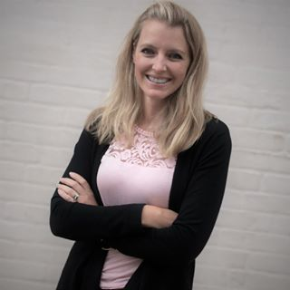
Alison brings with her 15 years of hands-on global leadership experience. She lived abroad in Denmark for 9 years and has visited over 20 countries.
Having sat in the C-Suite chair of a dynamic, fast paced global Tech company and led a global team in a large MedTech company, she has experienced the many competing demands of day to day work that your people are facing.
She has designed & facilitated leadership & wellness programs across 35+ countries with many blended learning components.
These experiences help her to easily relate and bring immediate impact to the people and organizations she supports along with her five core strengths:
A “maximizer”. Transforming something from good into great.
“Strategic” Seeing the big picture, creating alternative ways to proceed and quickly spot and suggest steps to resolve any issues.
”Individualization” – An ability to easily figure out how different people can work together productively.
“Arranger” Making sure all the moving parts fit together perfectly while still being flexible in adapting as plans change.
Finally, an innate “positivity” that will bring a contagious enthusiasm to you and your organization.
About your partners
Alison Egeberg
Certified LPS Facilitator, Former HR Executive, Executive coach, Fitness & nutrition coach,
Wife & Mom
Avid traveler

Slide 16
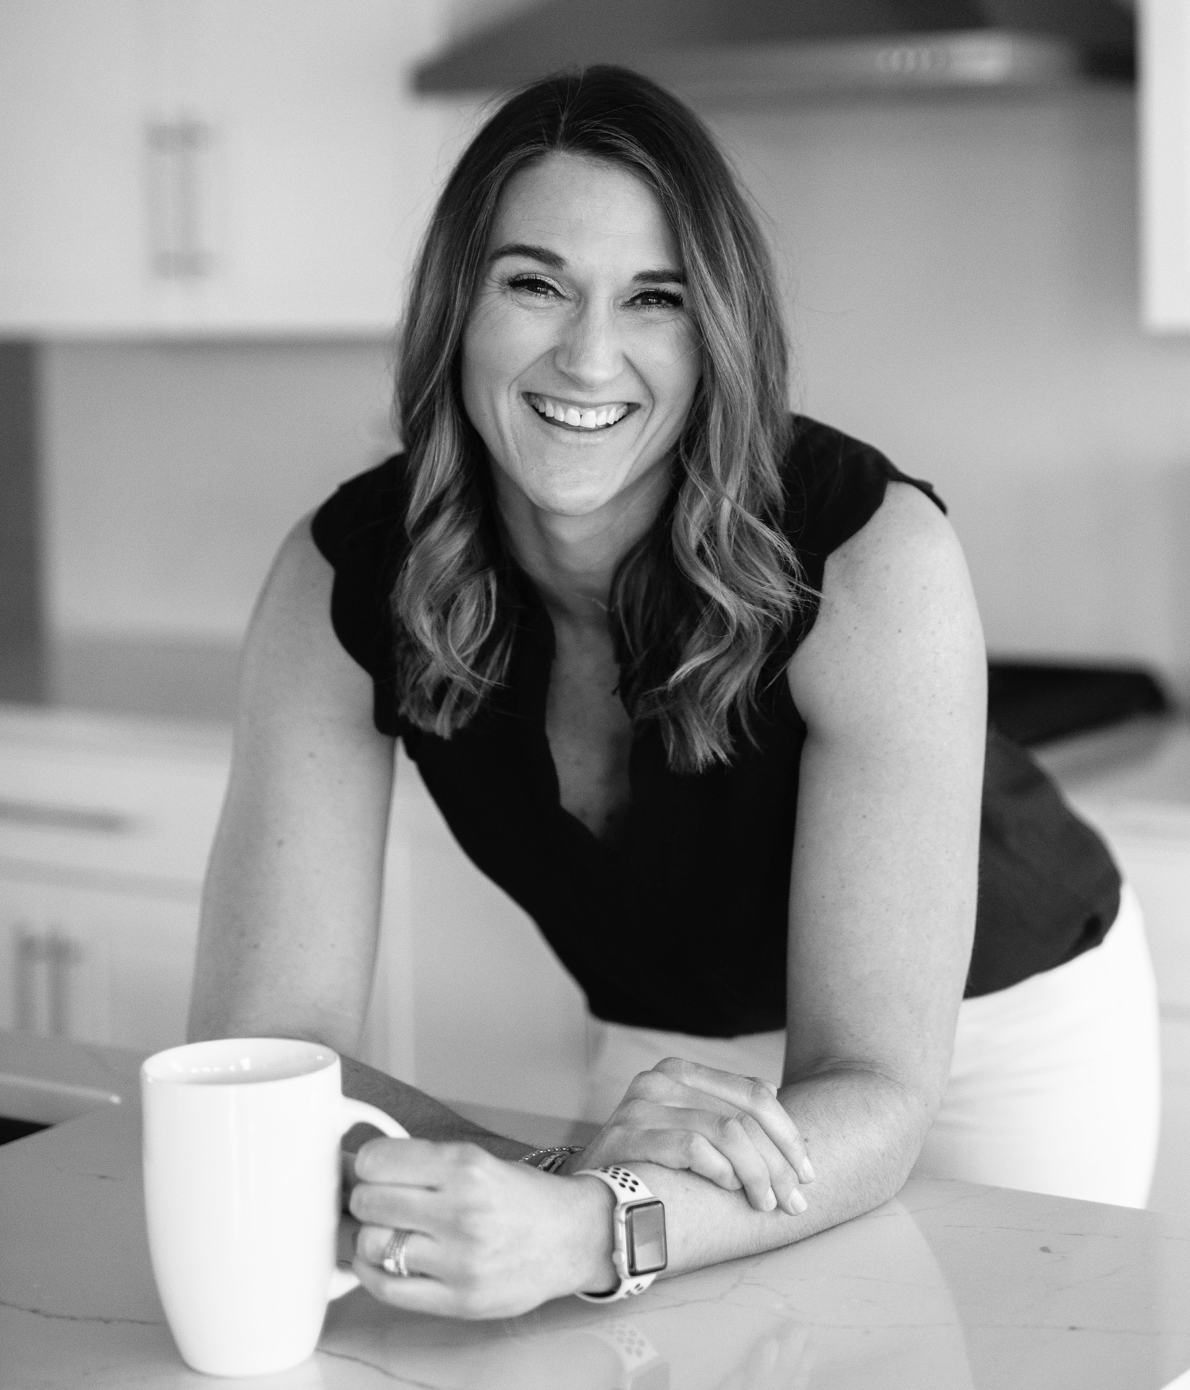
Lindsey is a purpose-driven leader, facilitator, trainer and coach. She brings over 10 years of expertise in recruiting, staffing, talent acquisition and business development. Lindsey has a proven track record of her commitment to success, exceeding expectations through meaningful relationships and high value service offerings.
Life transitions of a growing family and multiple relocations, shifted her focus to serving others more intimately on individual growth, personal development and wellness journeys. Her passion and holistic approach to Coaching was born from the idea that guiding others in their growth will inevitably, positively impact the individual, not to mention their family, organization and greater community.
Most recently, Lindsey was the Co-Founder of The Fulfilled Mom Movement, an online summit consisting of 20+ expert interviews offering resources and insights for today’s woman and modern mom. The intention of the expert advice included how to have clarity on purpose and values, increase self belief, to help people shape a life they love.
About your partners
Lindsey Kotelnicki
LPS Facilitator, former Recruiter & Search Firm Entrepreneur, MBA
Certified Nutrition, Fitness & Wellness Coach, Wife & Mom

Slide 17
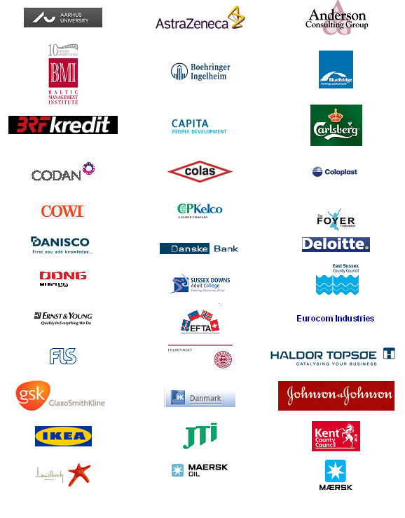
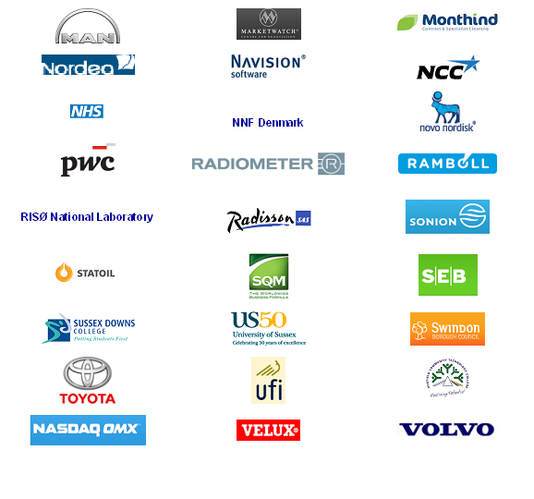
Previous Clients

Slide 18
We look forward to speaking with you to discuss further.

